Slide 1
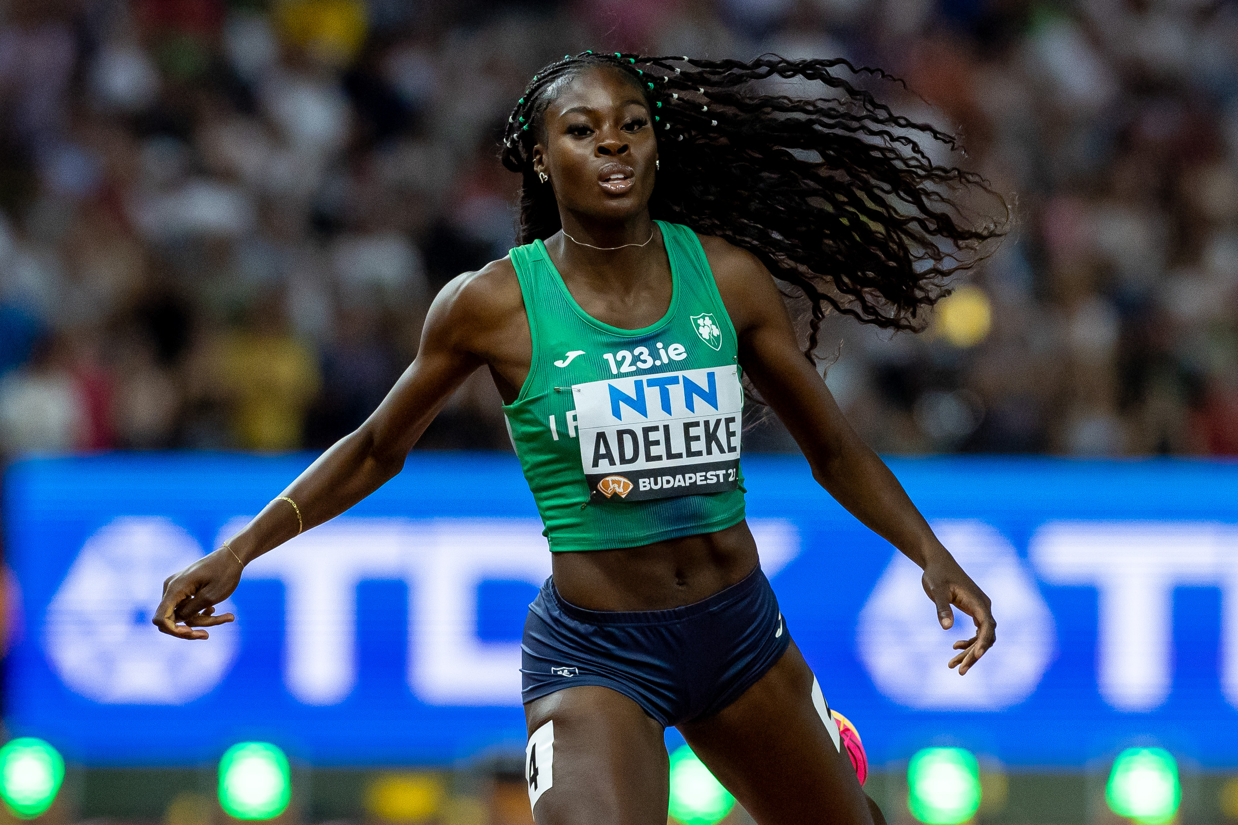
Space for NGB/LSP logo
DAY | THEME | WHAT’S ON
Monday March 3rd | Visibility
Tuesday March 4th | Coaching
Wednesday March 5th | Her Moves – Teenage Girl Participation
Thursday March 6th | Officiating
Friday March 7th | Leadership & Governance
Saturday March 8th | International Women's Day
Sunday March 9th | Active Participation
Space for additional logos
Notes:
INSTRUCTIONS:
To change the photo, right click on the photo (behind the main overlay graphic) and select “Change Picture” & browse for your photo on the computer.
You may need to scale up or down the photo you insert. Don’t worry if the photo extends beyond the edges of the slide, this will be trimmed when saved as a jpg. There’s no need to stretch or squeeze your photo to fit within the slide edges.
You should choose a suitable photo that works within the available shape.
Place your logo in the white space in the top left corner.
Place additional logos in the bottom white section.
Do not change the positioning or size of the main graphic.
The text in the table is editable to use your own text.
“Save” or ”Export” the slide as a jpg image for sharing online. Change the output size to at least 1000 pixels wide when saving/exporting.

Slide 2
Space for NGB/LSP logo
DAY | WHAT’S ON
Monday March 3rd
Tuesday March 4th
Wednesday March 5th
Thursday March 6th
Friday March 7th
Saturday March 8th
Sunday March 9th
Space for additional logos
Notes:
INSTRUCTIONS:
To change the photo, right click on the photo (behind the main overlay graphic) and select “Change Picture” & browse for your photo on the computer.
You may need to scale up or down the photo you insert. Don’t worry if the photo extends beyond the edges of the slide, this will be trimmed when saved as a jpg. There’s no need to stretch or squeeze your photo to fit within the slide edges.
You should choose a suitable photo that works within the available shape.
Place your logo in the white space in the top left corner.
Place additional logos in the bottom white section.
Do not change the positioning or size of the main graphic.
The text in the table is editable to use your own text.
“Save” or ”Export” the slide as a jpg image for sharing online. Change the output size to at least 1000 pixels wide when saving/exporting.

