Slide 1

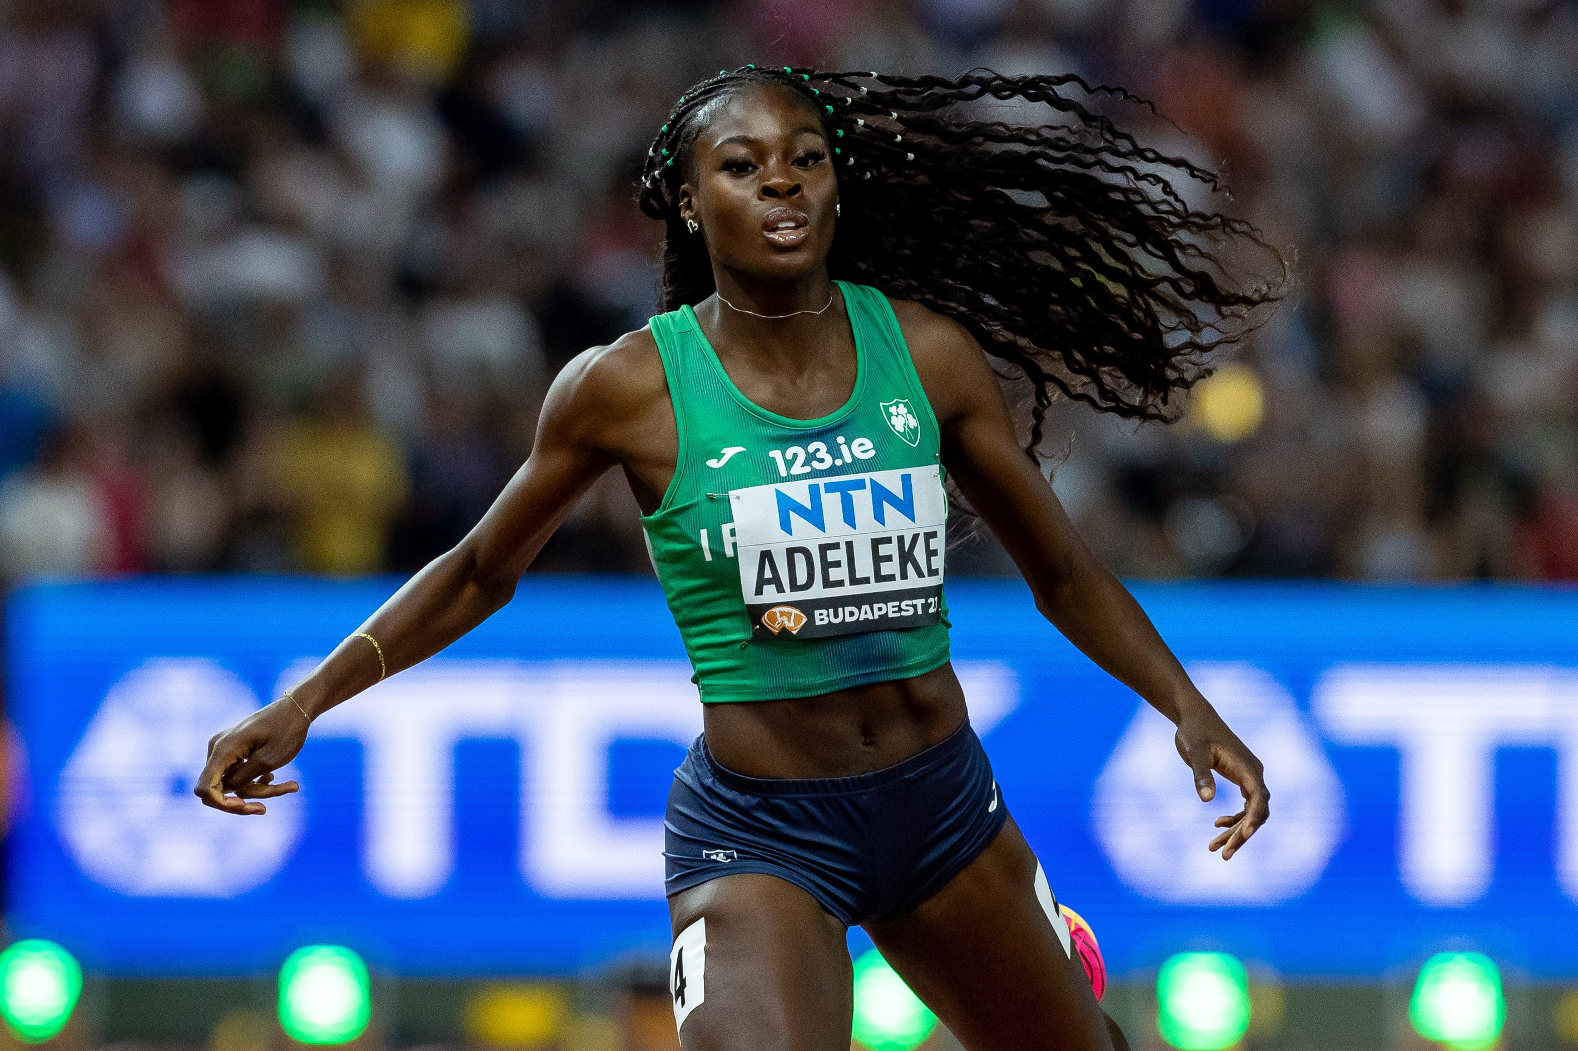
Space for NGB/LSP logo
Space for editable text..
Space for additional logos.
Notes:
INSTRUCTIONS:
To change the photo, right click on the photo (behind the main overlay graphic) and select “Change Picture” & browse for your photo on the computer.
You may need to scale up or down the photo you insert. Don’t worry if the photo extends beyond the edges of the slide, this will be trimmed when saved as a jpg. There’s no need to stretch or squeeze your photo to fit within the slide edges.
You should choose a suitable photo that works within the available shape.
Place you logo in the white space in the top left corner.
Place additional logos in the bottom right section.
Do not change the positioning or size of the main graphic.
The text in the space on the the left hand side is editable to use your own text.
“Save” or ”Export” the slide as a jpg image for sharing online. Change the output size to at least 1000 pixels wide when saving/exporting.

