Slide 1
Anti-Doping Education Sport Ireland AD Forum 25th Jan 2023 Paul O’Donovan

Slide 2
Layout
Education and Compliance (ISE)
2021/2 Education Highlights
Sport Ireland AD Education Plan 2023

Slide 3
Background www.sportireland.ie/anti-doping

Slide 4
Sport Ireland Anti-doping Unit
Testing
Intelligence & Investigations
Prevention and Education
Education should always be an athlete’s/ASP’s first experience of anti-doping!
Notes:
Education should always be an athlete’s/ASP’s first experience of anti-doping!
Emphasise - athlete centric approach

Slide 5
What is Anti-Doping in Sport?
Any practice or programme that promotes doping-free sport
(WADA)

Slide 6
World Anti-
Doping Agency
International Federation
Sport Ireland
NGB
Notes:
IF eg IOC
Functions of Sport Ireland:
Testing
Education
Results management

Slide 7
World Anti-
Doping Agency
International Federation
Sport Ireland
NGB
EDUCATION PLANS
EDUCATION PLANS
Notes:
IF eg IOC
Functions of Sport Ireland:
Testing
Education
Results management

Slide 8
Education Plans www.sportireland.ie/anti-doping

Slide 9
Education – More than Compliance
Core (Supply Plan for following year)
Mid-Year Reivew (Versus Core Submission)
NB End of Year Evaluation

Slide 10
Education Requirements (Example)
Priority/Risk Category | ISE Content
Pool 1: RTP Athletes | NGBs in this pool are encouraged to provide the following (facilitated by Sport Ireland where necessary): Information Provision (e.g. up-to-date website) Awareness Raising – AD Wallet cards are circulated to all NGBs AD Education (e.g. E-Learning and F2F education seminars/workshops) Values-based Education as early as possible in athlete pathway New members on the RTP receive a letter from Sport Ireland outlining their rights and responsibilities as an RTP athlete (provided by Sport Ireland ADU) On membership of the RTP, all athletes receive education on ADAMS and updating Whereabouts for each Quarter (provided by Sport Ireland ADU) All ASP working with RTPs are encouraged to complete E-Learning and attend in-person education session(s)

Slide 11
Education – Delivered By
Sport Ireland?
NGB AD Tutor?
Partner NGB?
Athletes?
WHO

Slide 12
Education Plan Template
Section | Description
Target Groups | RTP Athletes, Athletes returning from sanction, ASP, Youth Athletes
Programme Objectives | X number of VB education sessions delivered to youth athletes
Mandatory Content | Consequences of doping
Learning Objectives | By the end of the education activity the athlete will be able to differentiate between healthy training practices and unhealthy ones
Education Activities | In-person workshops, webinar
M&E | See Below
Resources Used | Powerpoint slides, Sample collection kits

Slide 13
Monitoring and Evaluation
Programme Objective | Monitoring Procedures
 | Completed | Numbers Reached | Feedback | Education Component
100% of Olympians and Paralympians will complete | Yes | 116 Olympians and 29 Paralympians (15 education sessions) | Total Respondents = 34 88% very satisfied with AD education delivered 91% of respondents said their expectations were met Athletes felt somewhat dissatisfied with the opportunity to contribute in the session and also the lack of group activities | Values-based education AD Education

Slide 14
2021/2 AD Education www.sportireland.ie/anti-doping

Slide 15
Education – Key Points
2021 | 2022
57 (Over 1800 attendees)* | 24 (Over 1000 attendees)
Implementation of ISE (Education Plan) | Evaluation of 2021 Plan
Tokyo Olympics and Paralympics | EYOF, Beijing
Tutor Training (CPD) | 10 Tutors Certified
2022 Prohibited List Education | Medicine Checker Website

Slide 16
2023 AD Education www.sportireland.ie/anti-doping

Slide 17
2023 Education – Key Points
2023
Medicine Checker Website
Review Data Collection Procedures
Development of 2023 Education Plan (ongoing)
QA for Tutor Training Programme
Paris 2024
2024 Prohibited List - Tramadol

Slide 18
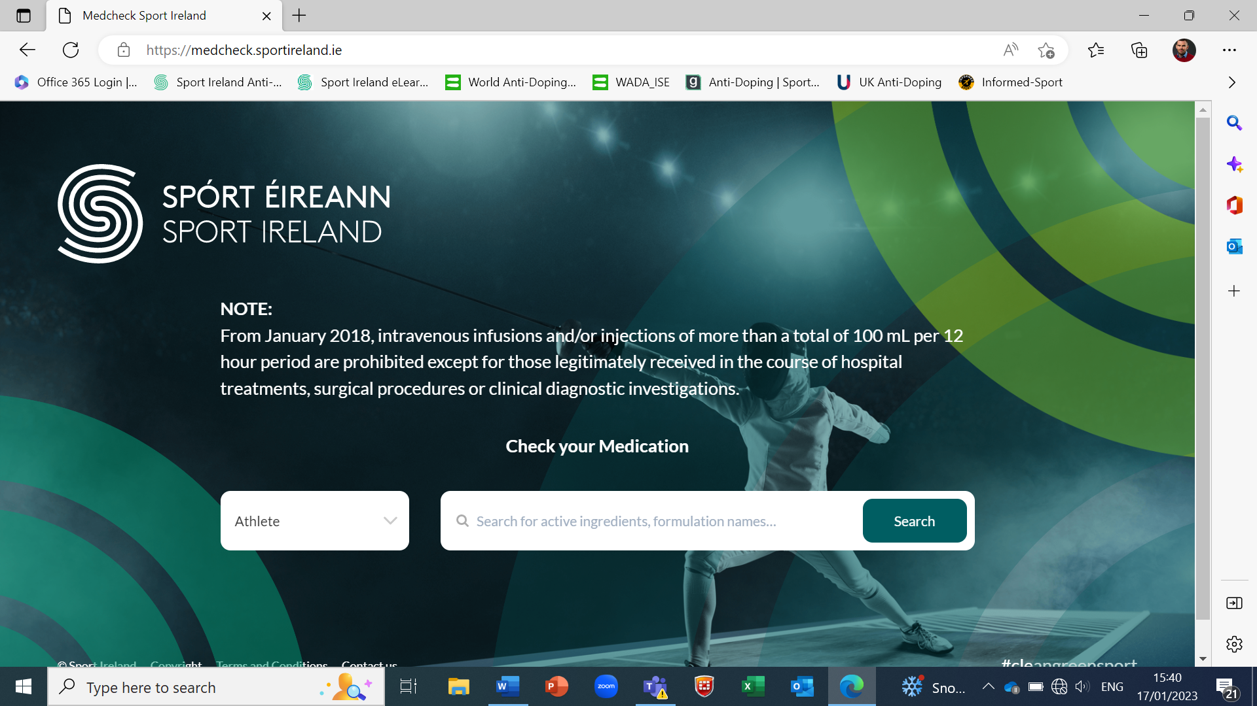
Republic of Ireland
Notes:
Sport Ireland will have a media campaign to announce the new website once it is live

Slide 19
Task 1
Using Med Checker Website:
Check which (if any) of the following is/are prohibited:
Seretide Evohaler
Zirtek
Ritalin
Notes:
NB pseudoephedrine in Cold and Flu medications – Nurofen Cold and Flu, Lemsip Flu Strength

Slide 20
Thank You

Slide 21
Questions?

Slide 22
Practical 2 - Education Activities

Slide 23
Values-Based Education
Belief upon which a person acts by preference
Describe the personal qualities you chose to guide your actions
Describe the sort of person you want to be
How you treat yourself and others, and your interaction with the world around you
Provide the general guidelines for conduct

Slide 24
In Pairs
Sell your individual Value
Are they reflected in your sport

Slide 25
Culture can be created good or bad

Slide 26
PBTR (Australia)
The purpose of sport for many is to win...reinforce that the manner in which this objective is achieved is also very important.

Slide 27
Sample EDM Framework

Slide 28
Slippery Slope
‘It was just one mistake’ ‘Nobody’s perfect’
‘I had no choice’ It’s not hurting anyone’
‘It’s a stupid rule anyway’ ‘It not illegal, so no problem’
‘Everybody does it’ ‘If I don’t do it I’ll miss out’
‘It’s not my fault’ ‘My coach made me do it’

Slide 29
Task – Flip Charts
Groups of 5/6
Design a VB Education Session on Supplement Use

Slide 30
Anti-doping Rule Violations

Slide 31
Strict Liability
Your Body.
Your Responsibility.
Notes:
The principle of Strict Liability states that an athlete is wholly responsible for any prohibited substance found in their system, regardless of how it got there and regardless of whether they intended to cheat or not. Ignorance is no excuse.

Slide 32
GAME - Anti-Doping Rule Violations
Notes:
These are Doping Violations for which an athlete can be sanctioned as outlined in the WADA Code – highlight for e.g. Its not just a substance being found in your urine or blood sample, but possession of prohibited substances.

Slide 33
Thank You

