Slide 1
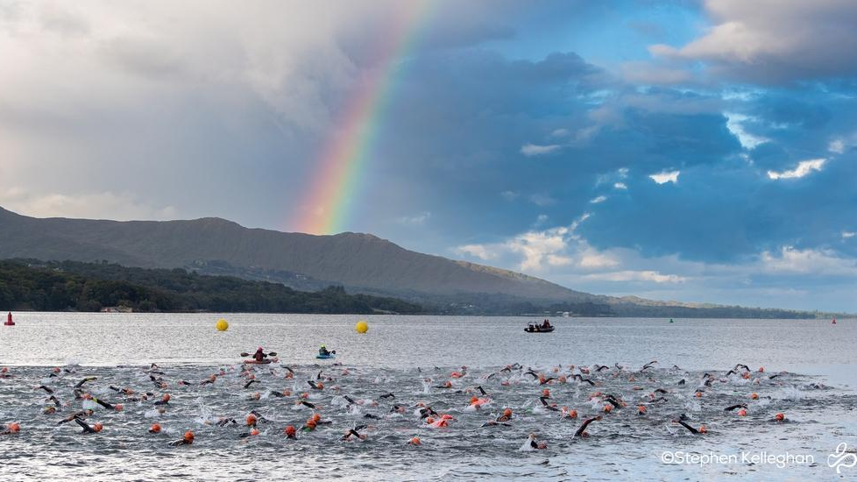
Triathlon Ireland
Anti Doping
The role of an Anti Doping Officer

Slide 2
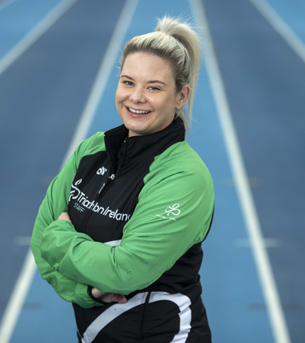
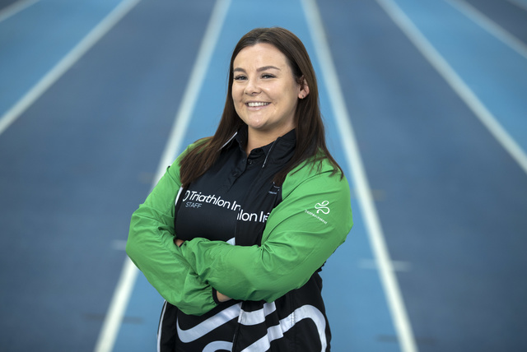
NGB of Triathlon in Ireland
International Federation is World Triathlon
Medium Size NGB
23 Staff
Ranked Level 4 in World Triathlon Federations
1 Anti-Doping Officer
2 Anti-Doping Tutors

Slide 3
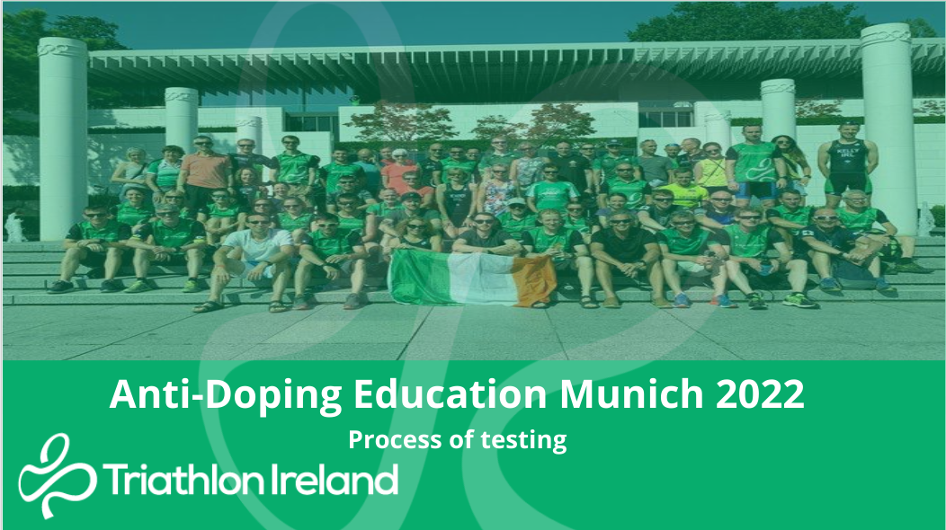
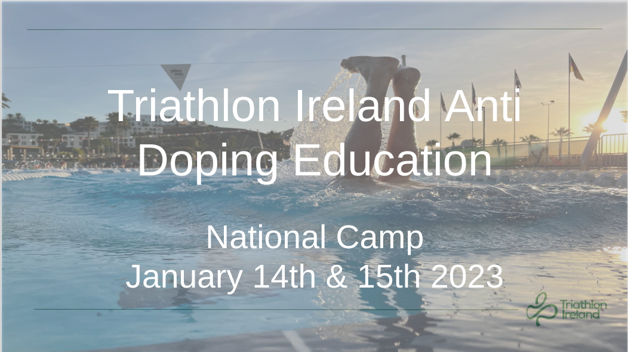
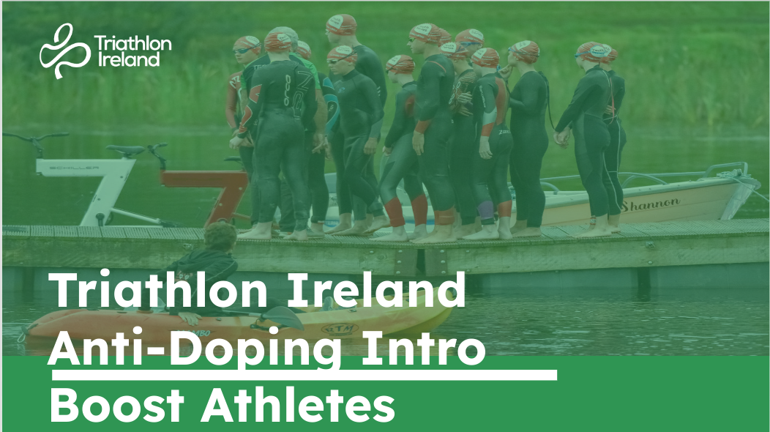
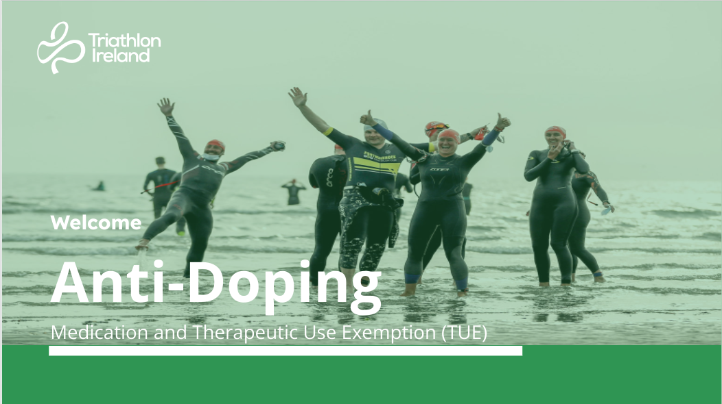
The Role

Slide 4
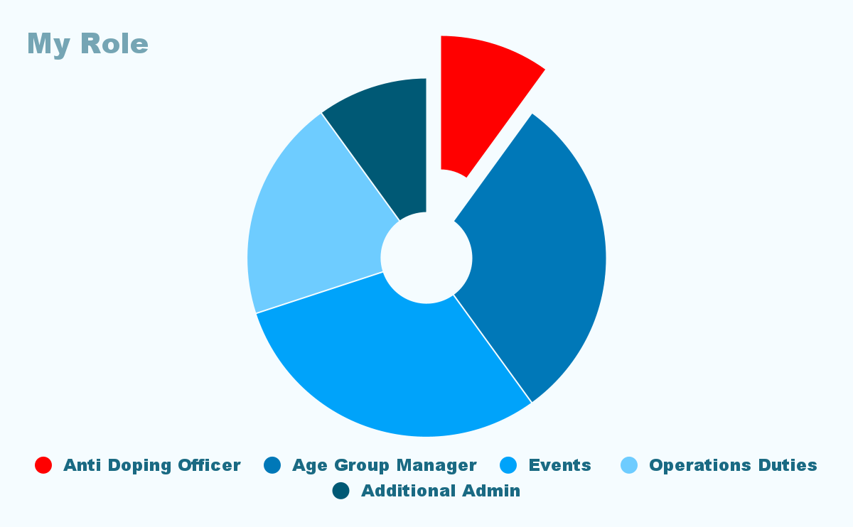

Slide 5
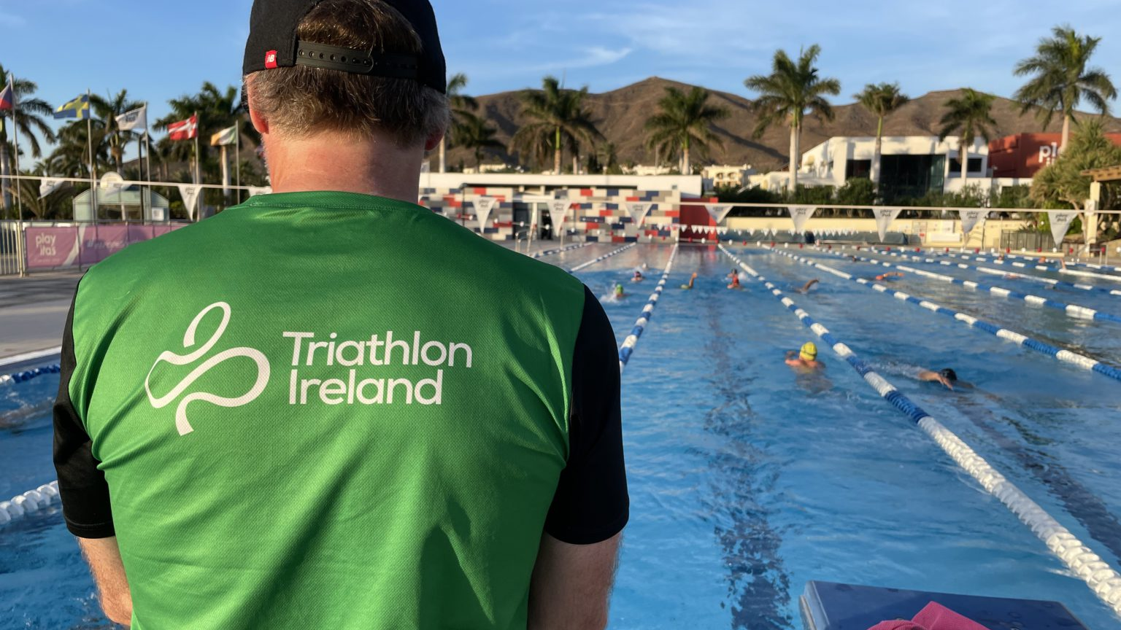
Modes of Education
Complete the Sport Ireland online education annually
  Email certificate
Face to Face education every two years.
  Receive certificate
Be aware of any changes to the WADA prohibited list.

Slide 6
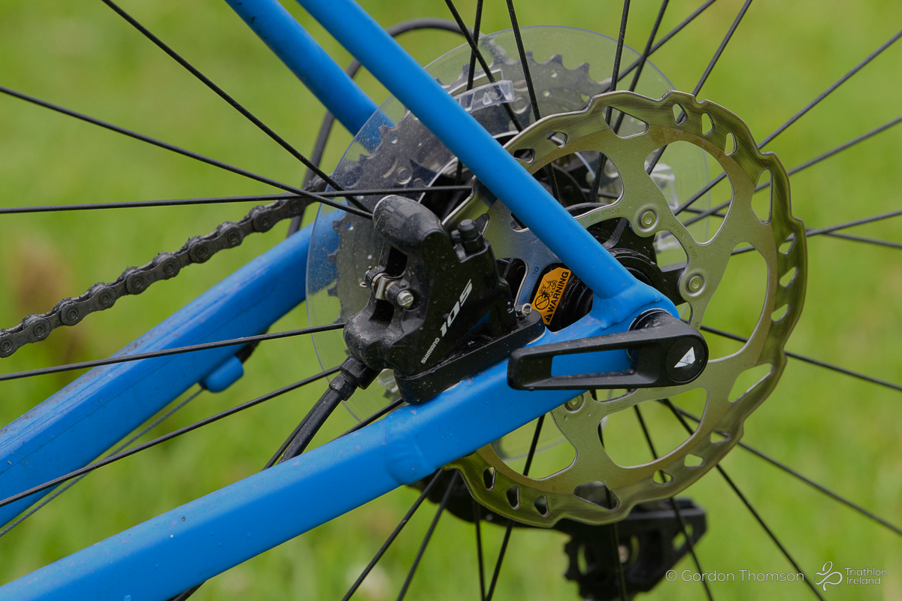



Relationships
Anti Doping Education

Slide 7
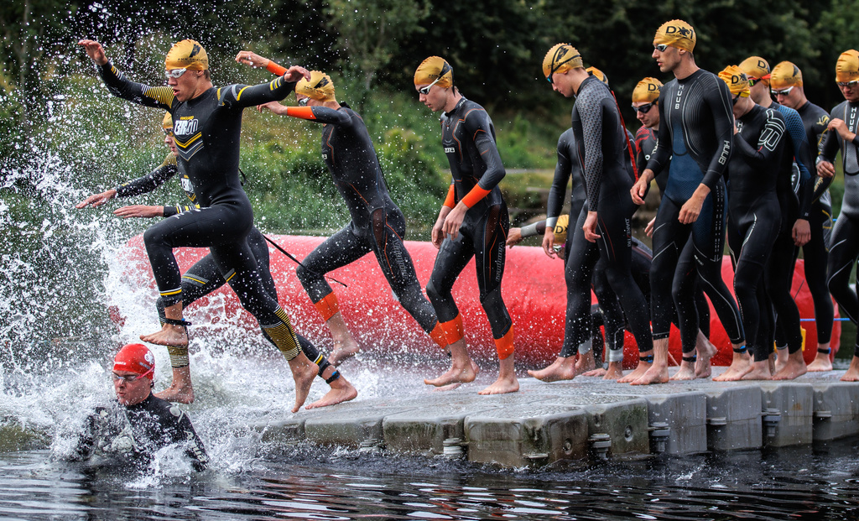
Solutions
Reducing over-education
Finding new formats to deliver education
Education on athletes experiences

Slide 8
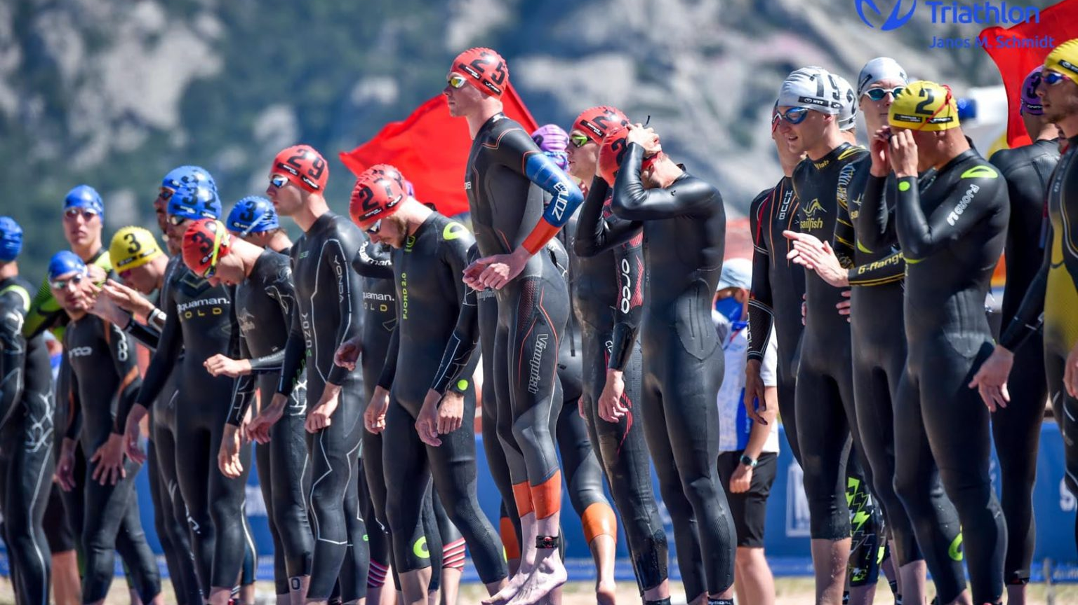
Athlete Voice

Slide 9
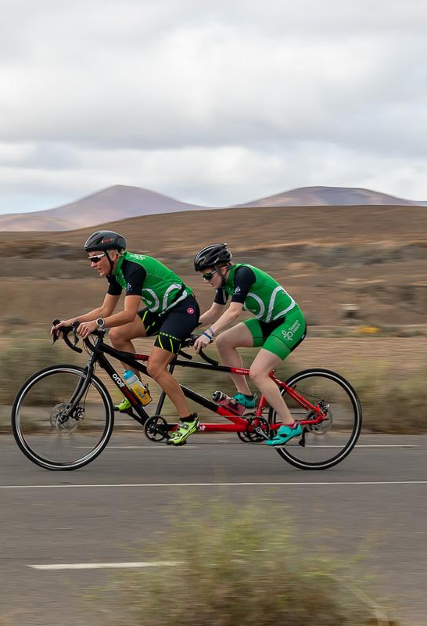
Accessibility
VI Athletes at workshop
  Ask
  Provided the workshop on an accessible platform
    Whatsapp
    Clear Projector
  Issue all materials post workshop
  Follow up

Slide 10
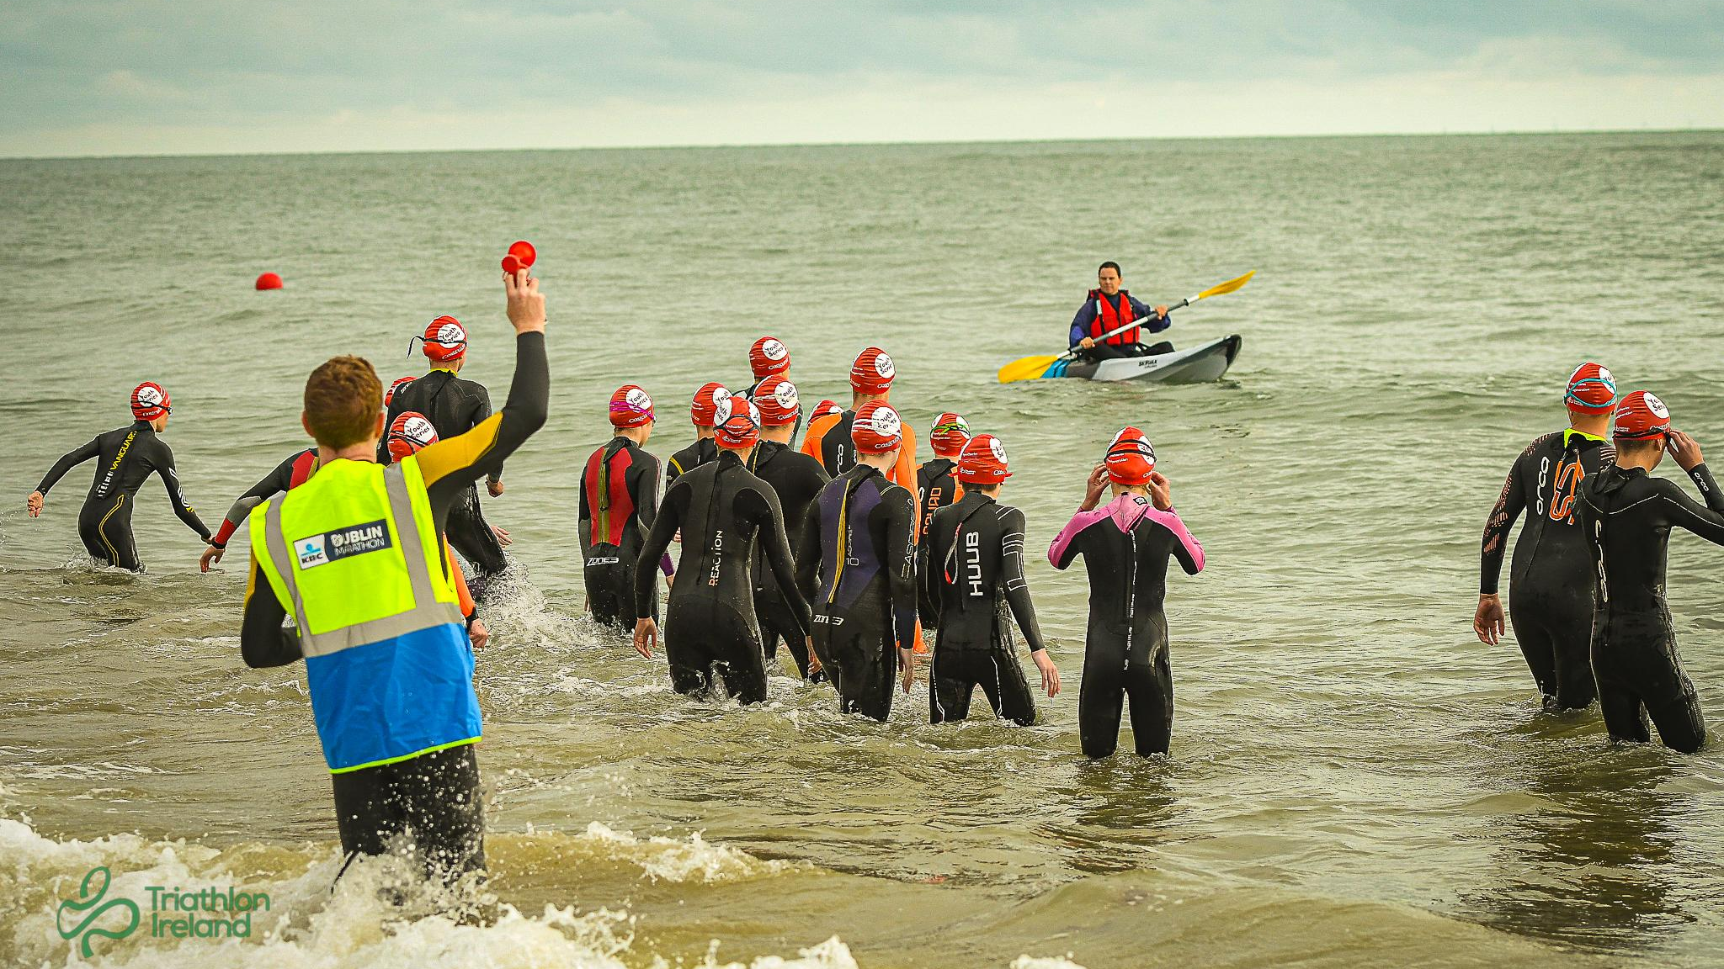
Activity

