Slide 1
How to Develop a Coach Education Programme As part of the Coaching Development Programme for Ireland 8th December 2021

Slide 2
130 coach awards
53 NGBs
20,000-25,000 coaches certified annually

Slide 3
Steps for Developing CDPI Programmes
Develop the Programme and Support Materials
External Programme Review
Approval by Sport Ireland Education and Training Council

Slide 4
Step 1: Develop the Programme
Complete Programme Scoping document
Title of the programme
Target learners
Rationale for the programme
Alignment with NGB goals
Identification of relevant partners
Broad programme learning outcomes & delivery format
Potential links to relevant awards or frameworks
Timeline for development of programme
Resources required
Discussion and Approval with Sport Ireland Coach Education Officer

Slide 5
Step 1: Develop the Programme
Nominate Programme Lead Officer
Establish NGB Programme Development Team
Document programme on CDPI Prog Descriptor Template (CDPI Standard)
Develop support materials e.g. Assessment strategy, Coach Developer Resources, Coach Notes/Handbook
Complete Self-Evaluation Report (Self-Assessment against CDPI Approval Criteria)
Notes:
The Programme Development Team should consist of suitably qualified and experienced people who are available to complete the required workload within the specified timeframe. The Programme Lead Officer must liaise with the Sport Ireland Coaching CEDO on a regular basis during the programme development process

Slide 6
CDPI Approval Criteria (x 13)
Learning outcomes are consistent with the CDPI award sought
Satisfactory rationale for the programme & stakeholder involvement
Arrangements for Access, Transfer & Progression
Criteria & Procedure for Recognition of Prior Learning
Clear & appropriate info for learners
Documented and well-structured programme syllabus
Sound teaching and learning strategies
Sufficient qualified and capable Coach Developers & support staff
Sufficient time for practical work for learners to apply content
Appropriate materials and guidelines for Coach Developers
Sound and clearly documented assessment process
Human, financial and physical resources identified
Well-presented & appropriate programme materials/resources
Notes:
Self-evaluate the programme against the CDPI Approval Criteria using the Self-Evaluation Report
Supported by your SIC Coach Education Development Officer
Additional follow-up work may be required prior to proceeding to Step 2: External Programme Review

Slide 7
Step 2: External Programme Review
Sport Ireland Panel of External Programme Reviewers
Minimum of two External Programme Reviewers (4-6 weeks)
Review programme (and support materials) against CDPI standard and approval criteria
Complete an External Programme Review Report
NGB Programme Lead Officer considers recommendations in Report and completes any subsequent action deemed necessary
Amended programme is then ready to proceed to Step 3
Notes:
Purpose of the Panel = External (unbiased) oversight & consistency of standards across awards.
Panel Members have expertise in coach education programme development in another NGB or area

Slide 8
Step 3: Education & Training Council
Guardians of the quality assurance of education and training across Sport Ireland Units.
Programme Descriptor Template and associated documents
Self-Evaluation Report
External Programme Review Reports
Approve the programme for delivery or refer programme back to NGB for further work
Quarterly Meetings (4 times per year – March, June, Sept, Dec)

Slide 9
Summary
Steps | Outputs | Main Responsibility | Timeline
Programme Development | Prog Descriptor Template Support Materials Self-Evaluation Report | NGB | NGB dependent
External Prog Review | External Programme Review Report | SIC QA Officer | 4-6 weeks
Education & Training Council | E&T Council Approval | SIC QA Officer | Quarterly (March, June, Sept, Dec)

Slide 10
Other Considerations
Building the Programme Delivery Team e.g. Coach Developers and Support Personnel
Registering each course in advance on Sport Ireland Coaching database (Who, When, What, How)
Submitting coach details to SIC after each course (Who, When, What, How)
CDPI Certification
Programme Review (every 5 years)
Notes:
Who in the NGB will submit the information?
When will they submit the info? (1-2 weeks before a course is due for delivery, coach details submitted through SIC completion form once some coaches are ‘complete’)
What info will they submit e.g. location, dates, times, CDs, emails, DOBs, addresses?
How will they do it e.g. through SIC database, SIC course completion form

Slide 11
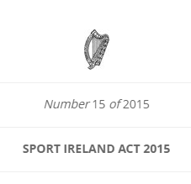
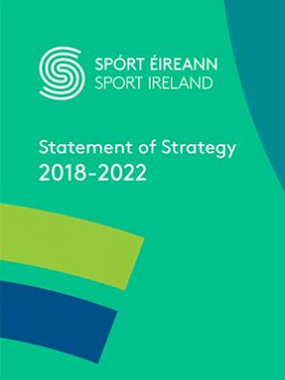
Guiding Policy & Strategic Documents

Slide 12
Thank You & Questions

