Slide 1
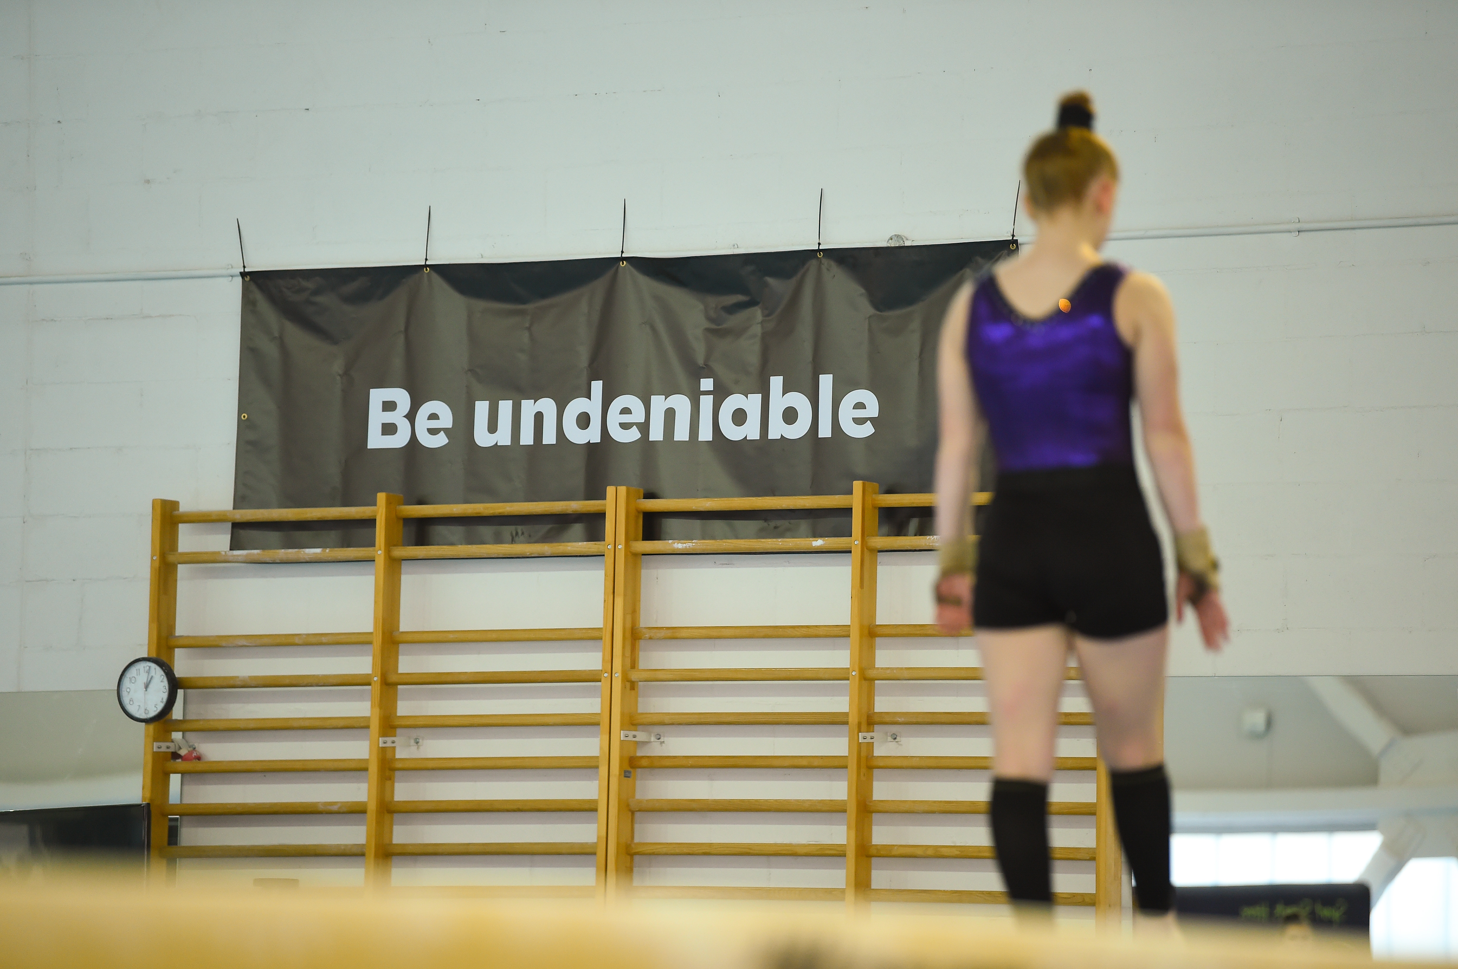

EUROPEAN WEEK OF SPORT
2020
Create Your Own Assets Guide

Slide 2

Notes:
THIS IS A WORKINGS SLIDE TO PREPARE YOUR IMAGE:
Inserting Your Image:
To add your image onto the slide using one of the following methods:
Right-Click the image above & select “Change Picture”
Drag & drop an image to the slide
Under the insert tab of the ribbon the insert -> picture -> Then browse to the image you wish to add to the PPT
The image will now be overlaid on top of the slide – depending on the dimensions & style of the photo file you have added you may need to tweak the shape
Re-Size the image to ensure that it covers the entirety of the slide
Position your image to ensure that the focus of the photograph appears centre-right of the slide
If the image runs over the edges of the slide, do not worry as this will be corrected when we save the final image)
Note: Only stretch / reduce the images by dragging from the corners of the image to ensure that you do not distort the quality of the image by stretching vertically / horizontally
Adding The Image Overlay
Once the image on slide 2 is positioned correctly, go slide 3
Right-Click & Add Your Organisation Logo using the orange instruction box to the bottom right first
Then select & copy all content on slide 4 (overlay & logo) & then paste the contents into the very same position (i.e. no need to change the location of the overlay)
If the overlay is blocking the focus point of the image, you may need to delete the overlay, adjust the position of the image on the slide & re-do points 1-3
Exporting / Saving Your Created Image:
Save / Export the slide as a jpg image for sharing online. Change the output size to at least 1000 pixels wide when saving/exporting.

Slide 3


Notes:
THIS IS A WORKINGS SLIDE TO PREPARE YOUR IMAGE:
Inserting Your Image:
To add your image onto the slide using one of the following methods:
Right-Click the image above & select “Change Picture”
Drag & drop an image to the slide
Under the insert tab of the ribbon the insert -> picture -> Then browse to the image you wish to add to the PPT
The image will now be overlaid on top of of the slide – depending on the dimensions & style of of the photo file you have added you may need to tweak the shape
Re-Size the image to ensure that it covers the entirety of the slide
Position your image to ensure that the focus of the photograph appears centre-right of the slide
If the image runs over the edges of the slide, do not worry as this will be corrected when we save the final image)
Note: Only stretch / reduce the images by dragging from the corners of the image to ensure that you do not distort the quality of the image by stretching vertically / horizontally
Adding The Image Overlay
Once the image on slide 3 is positioned correctly, go slide 4
Right-Click & Add Your Organisation Logo using the orange instruction box to the bottom right first
Then select & copy all content on slide 4 (overlay & logo) & then paste the contents into the very same position (i.e. no need to change the location of the overlay)
If the overlay is blocking the focus point of the image, you may need to delete the overlay, adjust the position of the image on the slide & re-do points 1-3
Exporting / Saving Your Created Image:
Save / Export the slide as a jpg image for sharing online. Change the output size to at least 1000 pixels wide when saving/exporting.

Slide 4
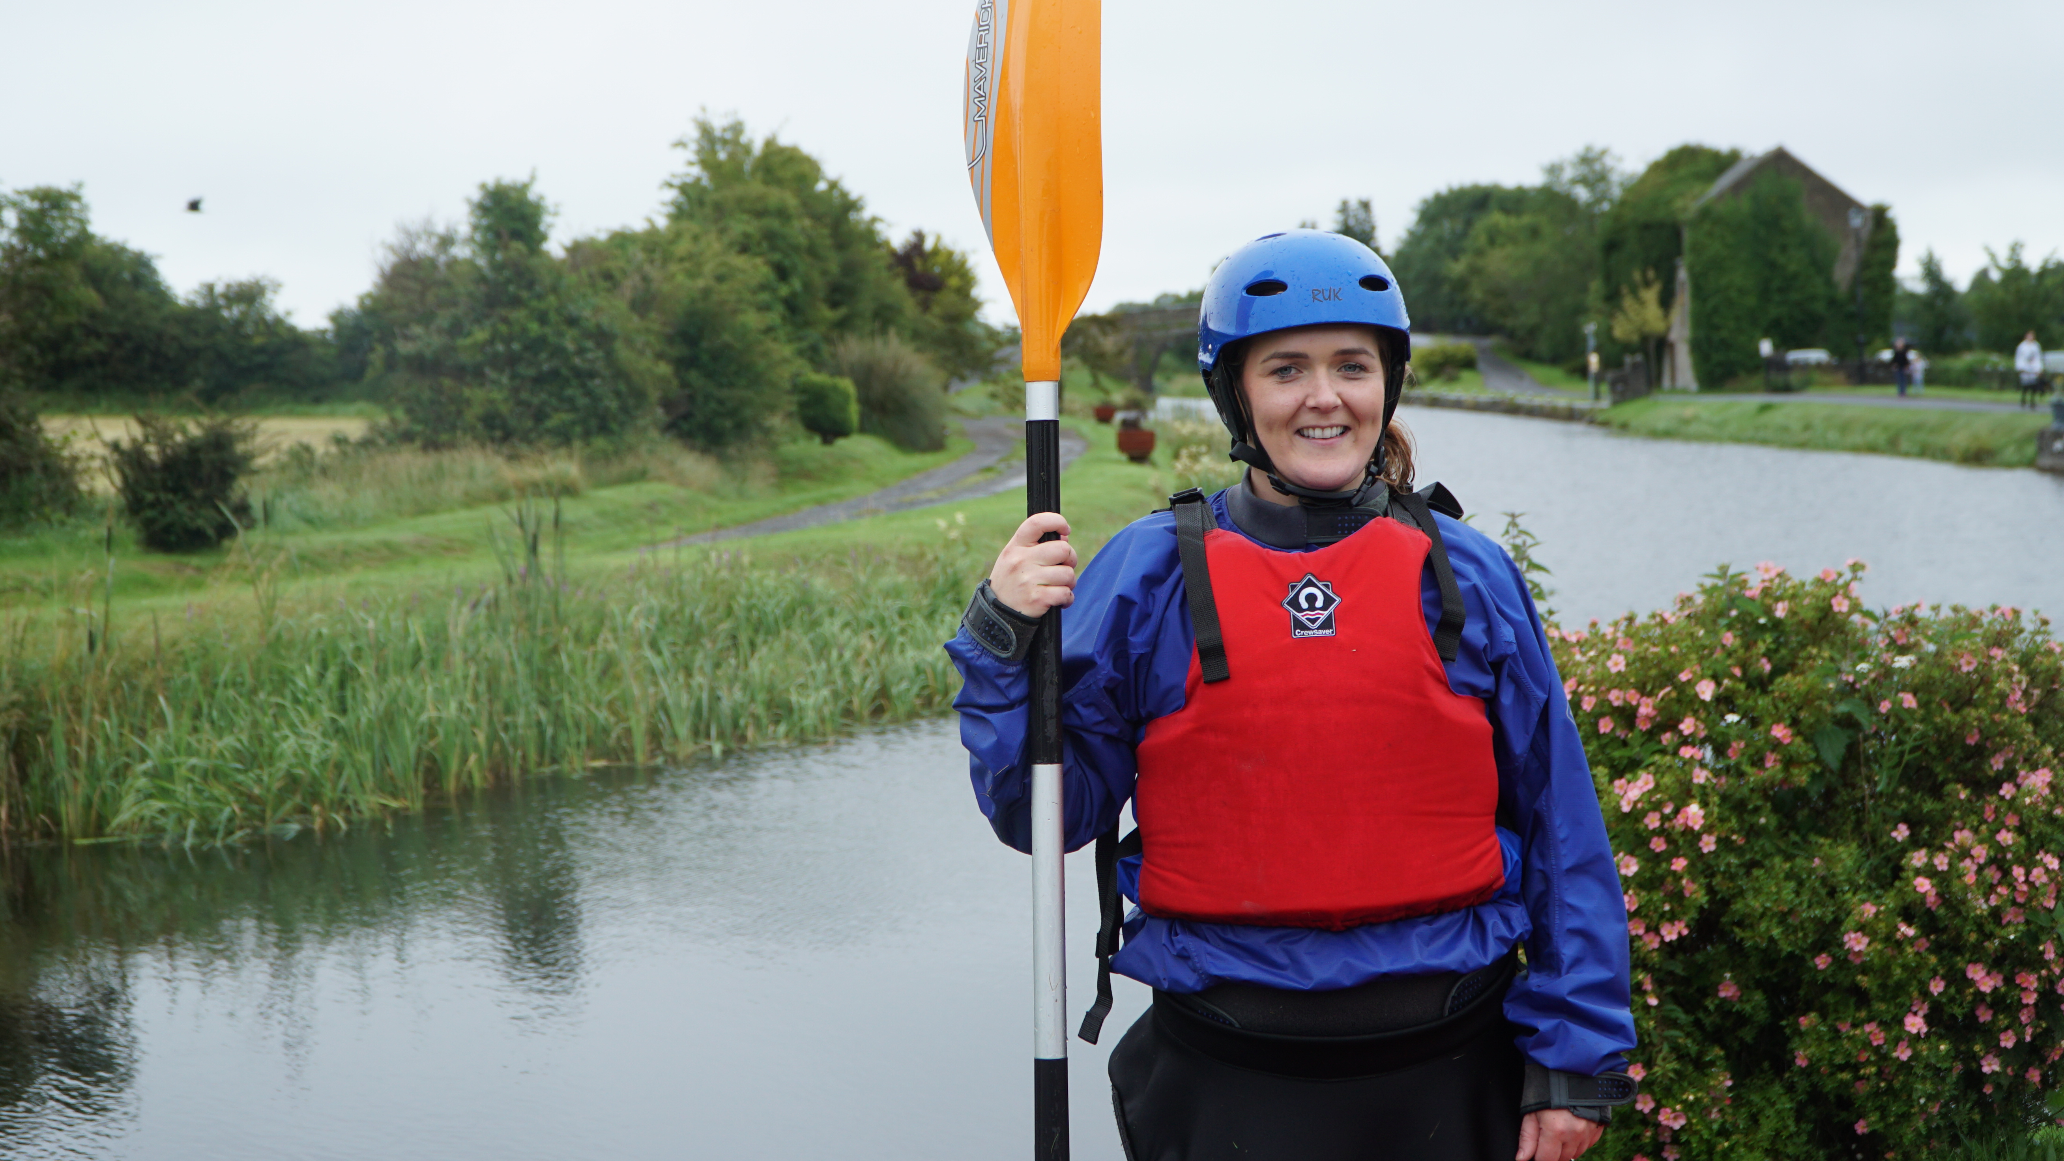

Slide 5
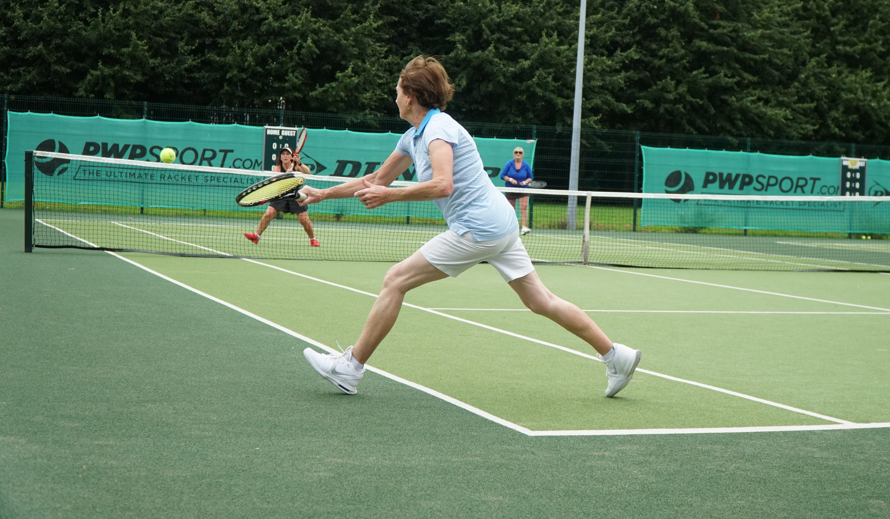

Slide 6
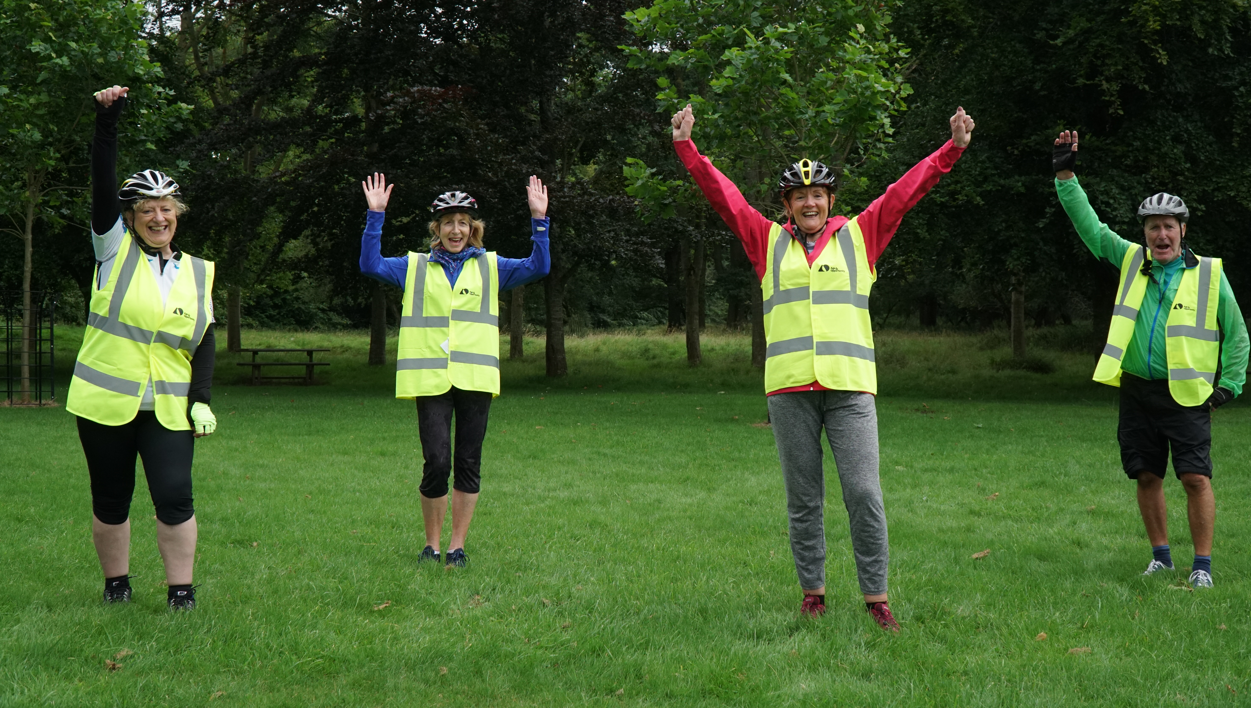

Slide 7


Slide 8
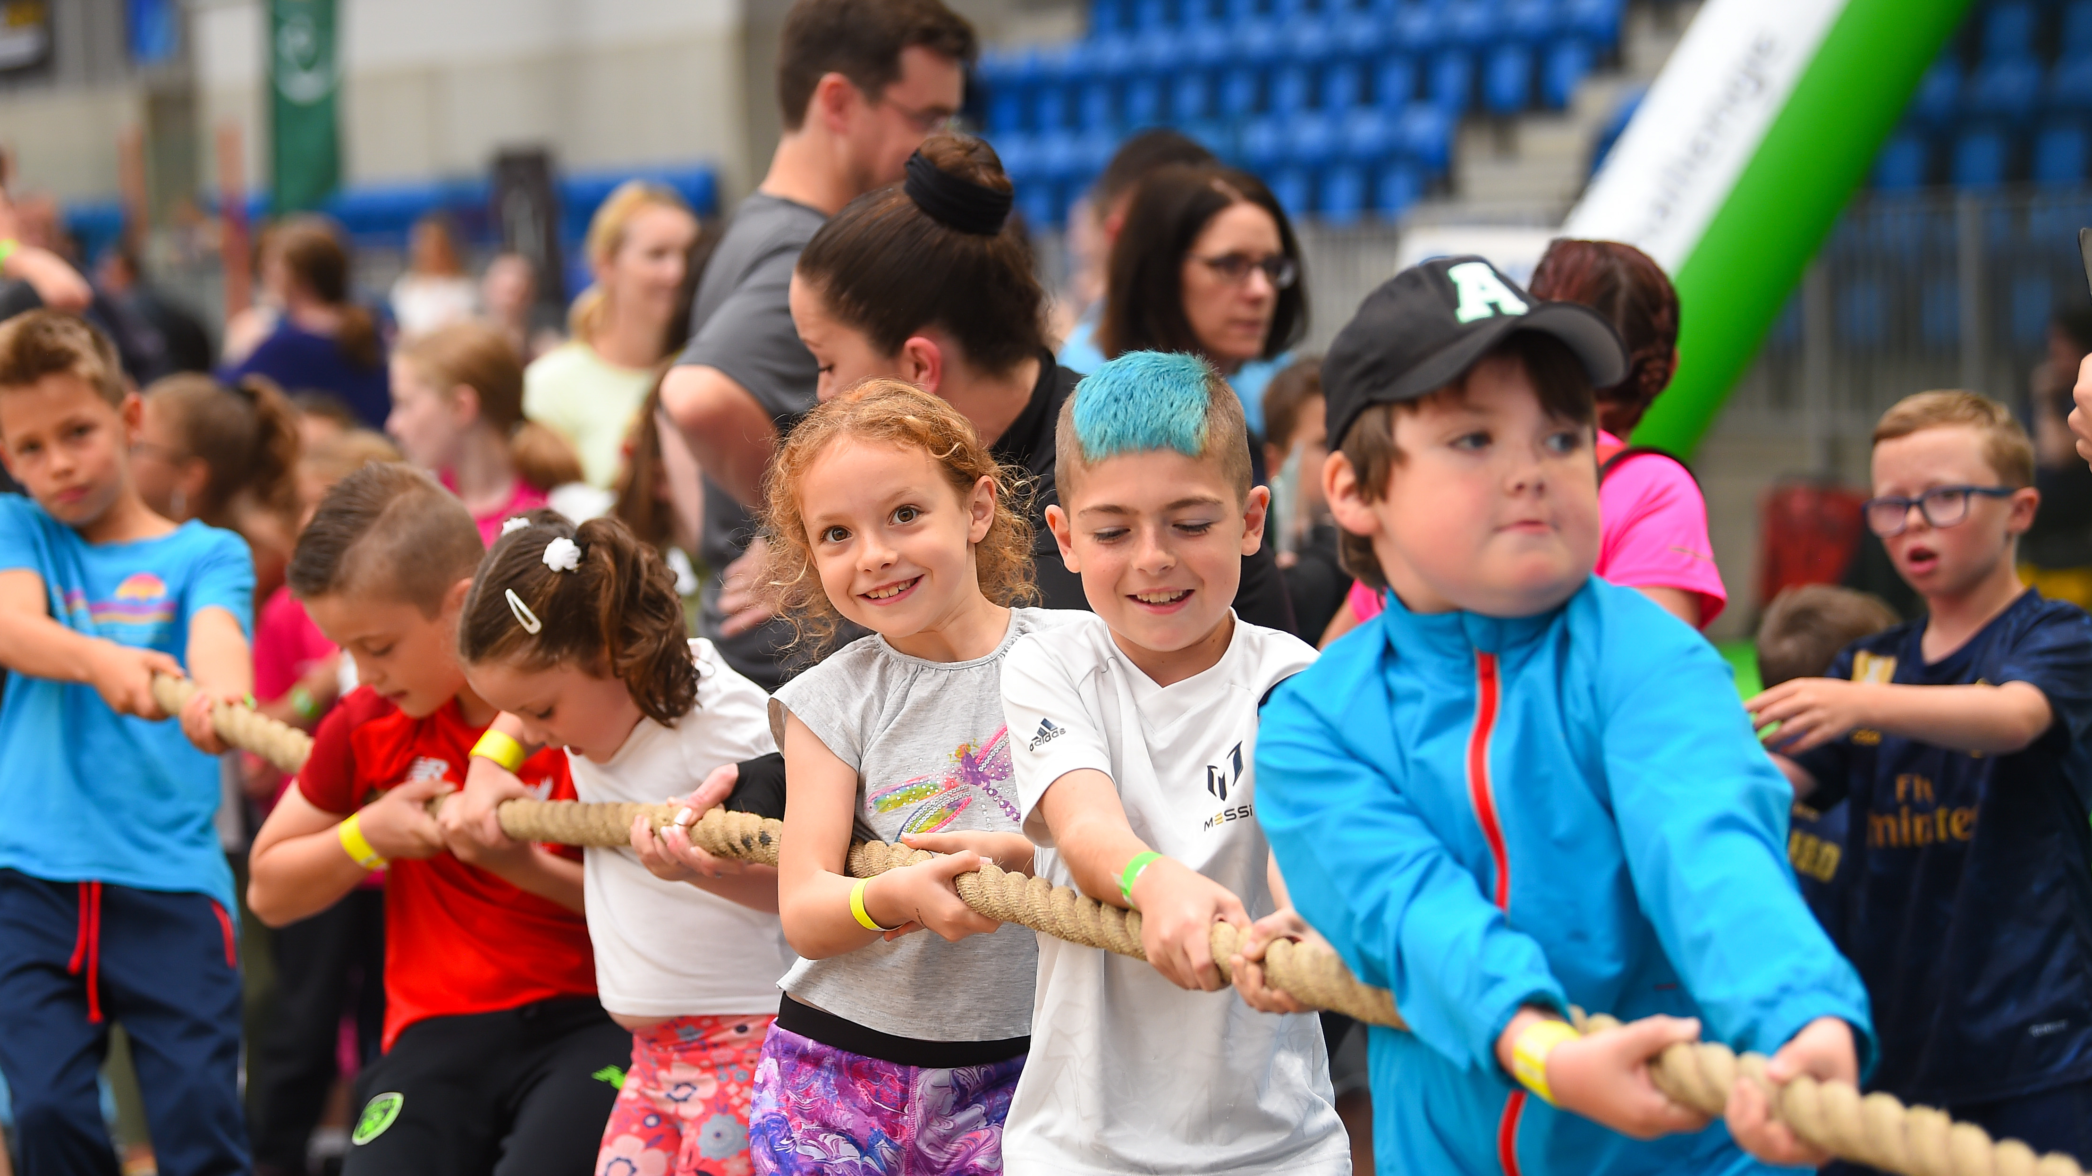


Slide 9
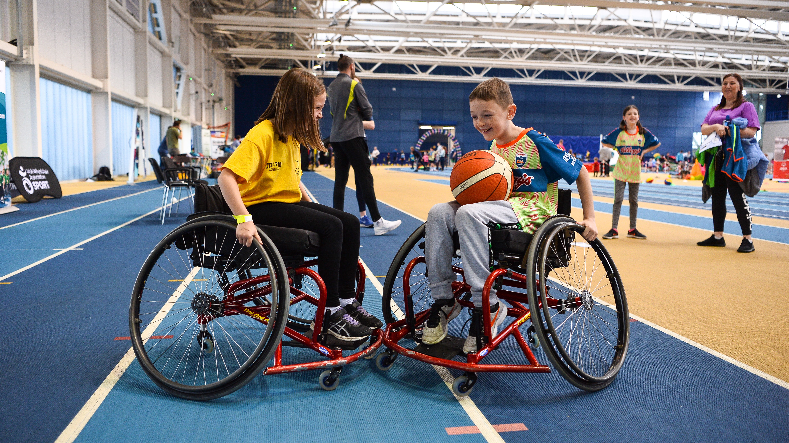

Slide 10
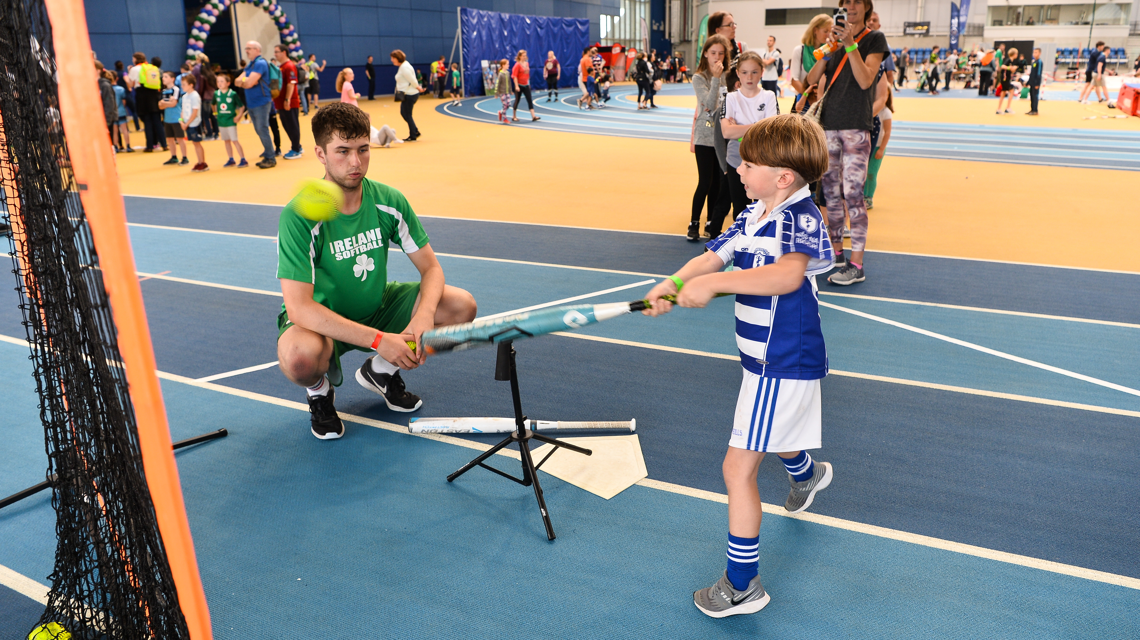


Slide 11


Slide 12
